Slide 1
One-Way
Between-Subjects Design
and
One-Way
Analysis of Variance
Notes:
One-way between Ss means that we have 1 IV, and that IV has 3 or more levels.
Our goal is to assess the difference among the means of those three or more groups.
An example of a one-way between subjects design that we would analyze using a one-way ANOVA is a study of spatial ability in children of different ages:
Age is IV
Levels of the IV could be 2, 4, and 6 years old

Slide 2
Experimental Designs/
Statistical Tests
One-Sample Experiments:
z-test
One-sample t-test
Two-Sample Experiments:
independent-samples t-test
dependent-samples t-test
Notes:
We’ve talked about 1-sample experiments and the appropriate stats to use
We’ve talked about 2-sample experiments and the appropriate stats to use

Slide 3
Experimental Designs/
Statistical Tests
Three or More Sample Experiments with one IV:
Analysis of variance (ANOVA)
Notes:
Now we’re going to talk about experiments that use 3 or more groups (up to 6 or 8) and the appropriate stats to use.
Remember that we talked about one of the main advantages of having 3 or more groups
It gives us more info about the true relationship between the IV and the DV
Can graph it and see if the relationship is linear
Just like we talked about with 2 samples, we can have either independent or dependent groups
We will focus on independent groups in this chapter
Everything you’ve learned about designing experiments remains the same for 3-sample experiments
Still have to think about reliability, validity, how to manipulate your IV, how to measure your DV, who your participants will be, demand characteristics, etc.

Slide 4
Independent Samples t-Test
ANOVA
Randomly selected samples
DV normally distributed
DV measured using ratio or interval scale
Homogeneity of variance
Independent groups
Randomly selected samples
DV normally distributed
DV measured using ratio or interval scale
Homogeneity of variance
Independent groups
Notes:
Assumptions of ANOVA:
Same requirements for the independent-samples t-test
Groups don’t have to have the same #of participants, but they should be fairly close
In this unit we are only dealing with independent samples, so the assumption of independent groups is listed here as we compare ANOVA to the independent samples t test.
Later we will see that you can also conduct ANOVA on dependent samples, so independent groups is not an inherent requirement for using ANOVA in general

Slide 5
H₀: μ₁ = μ₂ = μ₃
Population 1, 2, 3
μ₁ = μ₂ = μ₃
Condition 1, 2, 3
Level of the IV
Notes:
As usual, the null hypothesis is that there are no differences between groups
Each group comes from the same population
Recall that with two independent samples, μ1 and μ2 were equal under the null hypothesis (represented by μ1 - μ2 = 0)
When you have 3 independent samples, all 3 μ values are equal under the null hypothesis (represented by μ1 = μ2 = μ3)

Slide 6
General Model for ANOVA
Sample A
H₀: μ₁ = μ₂ = μ₃
Population 1
Sample B
Sample C
Notes:
For an ANOVA, we are trying to determine if the 3 (or more) samples comes from one population or from different populations
The null hypothesis says that they all represent the same population
So there’s no difference between their means
It is written as H₀: μ₁ = μ₂ = μ₃

Slide 7
H_{A}: not all μs are equal
Population 1
Population 2
Population 3
μ₁
μ₂
μ₃
Condition 1
Condition 2
Condition 3
Level of the IV
Notes:
You might think that the alternative hypothesis would be H_{A}: μ₁ ≠ μ₂ ≠ μ₃
However, it’s possible that only some of the μ’s differ, but not others.
For example, μ1 and μ2 may differ, while μ2 and μ3 and μ1 and μ3 do not differ
So our alternative hypothesis is that not all of the μ’s are equal (which implies ➔ at least one population mean is different from another)
We generally do not get any more specific (e.g., trying to say which groups are likely to differ from the others)

Slide 8
General Model for ANOVA
H_{A}: not all μs are equal
Population 1
Sample A
Population 2
Sample B
Population 3
Sample C
Notes:
The alternative hypothesis says that at least 2 samples come from different populations
So the means of at least 2 groups are not equal
It is written as H_{A}: not all μs are equal

Slide 9
General Model for ANOVA
Sample A
Sample B
Sample C
Notes:
The ANOVA tests all means against each other in order to determine if each group represents the same population or different populations
So, it tests A vs. B, B vs. C, and A vs. C, as shown here.

Slide 10
General Model for ANOVA
Population 1
Sample A
Population 2
Sample B
Notes:
Compares samples A and B
If they differ, then they represent different populations

Slide 11
General Model for ANOVA
Population 1
Sample A
Population 3
Sample C
Notes:
Compares samples A and C
If they differ, then they represent different populations

Slide 12
General Model for ANOVA
Population 2
Sample B
Population 3
Sample C
Notes:
Compares samples B and C
If they differ, then they represent different populations

Slide 13
Why not just use 3 separate t-tests?
Notes:
The obvious question is “Why do we need a whole new type of statistical test if we could just test each of the pairs of samples using independent samples t tests just like we have before?”

Slide 14
Experiment-Wise Error
Sample A
α =. 05
Sample B
α =. 05
α =. 05
Sample C
Notes:
If you’re comparing the means of each group against each other group, why not use several independent-samples t-tests?
The answer has to do with the alpha level and the chances of making a type I error
If you set alpha = .05 and then do 3 different t-tests, there is a 5% chance you are making an error for each comparison
This increases your overall chance of making a type I error well above .05, and this is not acceptable
Using an ANOVA prevents this from occurring

Slide 15
Experiment-Wise Error Rate
Experiment-Wise Error Rate:
The Type I error rate for a set of t-tests
The probability that at least one of the t-tests that you conduct will contain a Type I error
If we conduct 3 t-tests, each with an alpha of .05, then the experiment-wise error rate is:
1 – (1 – .05)³ = .143
Notes:
The Type I error rate for a set of t-tests is called the experiment-wise error rate
This is the probability that at least one of the tests that you conduct will contain a Type I error
If we conduct 3 t -tests, each with an alpha of .05, then the experiment-wise error rate is 1 – (1 – .05)3 or .143

Slide 16
Experiment-Wise Error Rate
The ANOVA allows you to make multiple comparisons while keeping the experiment-wise error rate at .05

Slide 17
Numerator of the t formula
Notes:
The statistical tests we have learned most recently used the t statistic.
The numerator of the t formula reflects the actual (observed) difference between your two samples.
Independent-samples t-test ➔ difference between the two sample means
Dependent-samples t-test ➔ sample mean difference (the mean of the sample of difference scores)
This amounts to finding how much the two samples are different from each other.
Some of that difference comes from the fact that the two samples have been treated differently (subjected to different levels of the IV)
and some of that difference comes from the participants in the two conditions being different (if only minimally different in the case of the within subjects design, in that the same people are subjected to the different levels of the IV at different times, so they are not exactly the same because things change even for one person from moment to moment; also, extraneous environmental variables may also vary as the same person is subjected to the different conditions).

Slide 18
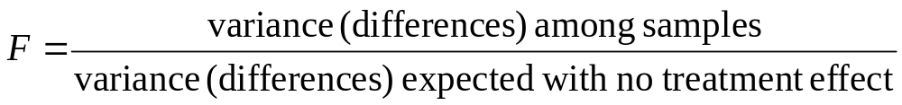
Numerator of F
The variance in the numerator provides a single number that describes the size of the differences among all of the sample means
Notes:
The same concept holds true for the ANOVA
The numerator of the F test is the variance among the samples
We use the variance instead of the difference because it would impossible to calculate the difference for more than 2 samples
The variance in the numerator provides a single number that describes the size of the differences among all of the sample means

Slide 19
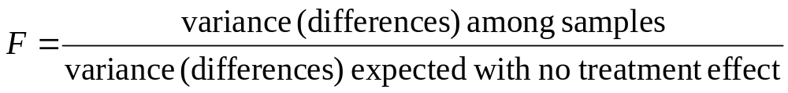
Denominator of t vs. F
Notes:
The denominator of the t-test is the standard error, which is the difference that we expect there to be between the samples when the null is true (and there is no treatment effect)
Likewise for the F test, the denominator is the variance (the ANOVA way of quantifying differences) expected between the sample means if the null was true (and there was no treatment effect)
Question: Why do we expect differences between our samples even if there is no treatment effect?
Answer: because of sampling error (even if there is no actual difference between or among the populations, when we take samples from each of them, the samples are unlikely to be perfectly representative of the populations,
so the samples can be expected to be somewhat different from each other and from the populations they come from)

Slide 20
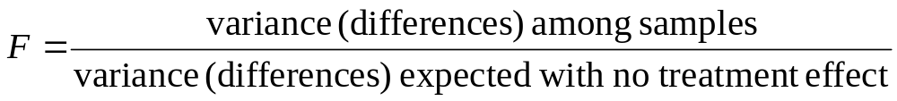
t vs. F
For both t and F:
The numerator measures the actual difference obtained from the sample data
The denominator measures the difference that would be expected if the H₀ were true
Notes:
For both t and F:
The numerator measures the actual difference obtained from the sample data
The denominator measures the difference that would be expected if the null hypothesis were true

Slide 21
ANOVA
What is an ANOVA?
Analysis of Variance

Slide 22
ANOVA
Group A | Group B | Group C
3 | 5 | 9
2 | 3 | 8
5 | 5 | 9
2 | 2 | 7
2 |  | 9
Mean = 2.8 | Mean = 3.75 | Mean = 8.4
Notes:
Remember when we talk about variance, we’re really talking about differences
When you look at the data in this table, you can see that there are differences among the scores (they are not all identical)
First, we notice that there are differences between the groups (we can tell this by looking at the means)
We also notice that there are differences within the groups
Within each sample, not every participant produced the same score

Slide 23
Analysis of Variance
Total Variability
Between-Groups Variance
Within-Groups Variance
Notes:
So total variability among the scores can be divided into:
between-groups variance
an estimate of the differences between groups
2. within-groups variance
an estimate of the differences within each sample
So let’s talk about each of these individually

Slide 24
Analysis of Variance
Total Variability
Between-Groups Variance
Within-Groups Variance
Treatment Effects
Chance (error)
Notes:
What can account for the variance between groups?
Treatment effect
The treatment had an effect
2. Chance (differences due to chance are referred to as error)
a. Can be due to differences between individuals
Not every person will score the same under the same conditions
Can be due to variability within individuals
Even if you measured the same person twice, he or she might not score the same each time

Slide 25
Analysis of Variance
Total Variability
Between-Groups Variance
Within-Groups Variance
Treatment Effects
Chance (error)
Chance (error)
Notes:
What can account for the variance within groups?
Chance (a.k.a., error)
This is the name given to any variance that is NOT due to the IV
Because the level of the IV is the same within a group, any variance within the group is going to be considered error variance.
So this is variance that would occur even if the null hypothesis were true (you would still have variability within the groups unless all the members of the group were clones)

Slide 26
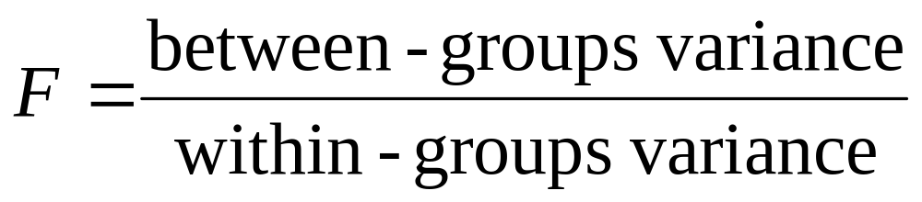
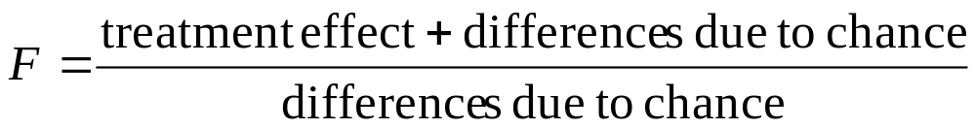
F-ratio
Notes:
To determine whether the treatment had an effect, we have to determine whether the differences between treatments are bigger than would be expected by chance alone
Remember that the differences that would be expected by chance (or, if the null hypothesis were true), are represented by the denominator
So the F ratio compares the between-groups variance in the numerator to the within-groups variance in the denominator

Slide 27
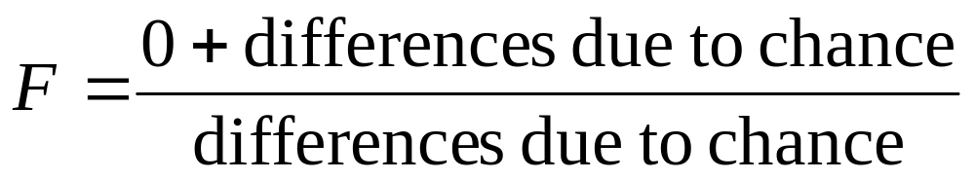
F-ratio
If the treatment does NOT have an effect:
An F-ratio near 1 indicates that the treatment did NOT have an effect
Notes:
When the treatment does NOT have an effect, the treatment effect will drop out (0), so it will be a ratio of differences due to chance between the groups and differences due to chance within the groups
They will be approximately the same
So the F ratio will be approximately 1
An F-ratio near 1 indicates that the treatment did NOT have an effect

Slide 28
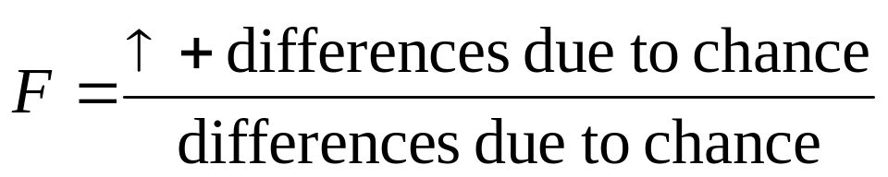
F-ratio
If the treatment has an effect:
A large F-ratio indicates that the treatment has an effect
Notes:
When the treatment has an effect, the numerator will be larger than the denominator
A large F-ratio indicates that the treatment has an effect (just like a large t did)
So, if the between-groups variance is large relative to the within-groups variance, then the F ratio will be large
The larger the F ratio is, the less likely it occurred by chance, so the more likely you are to reject the null hypothesis

Slide 29
An Example ANOVA
An experimenter is interested in the effect of music on memory for words. The data are shown on the next slide. Each score represents the number of words recalled. Analyze the data using the appropriate statistical test.
Notes:
Students should follow along on the example problem worksheet

Slide 30
An Example ANOVA
Country | Classical | Blues
3 | 5 | 9
2 | 3 | 8
5 | 5 | 9
2 | 2 | 7
2 |  | 9

Slide 31
Step 1. State the hypotheses.
A. Is it a one-tailed or two-tailed test?
ANOVAs are always two-tailed
B. Research hypotheses
Alternative hypothesis:
  The mean number of words recalled in at least one group differs from the mean number of words recalled in at least one of the other groups.
Null hypothesis:
  The mean number of words recalled when listening to country, classical, or blues music does NOT differ.
C. Statistical hypotheses:
H_{A}: not all μs are equal
H₀: μ_{country} = μ_{classical} = μ_{blues}
Notes:
Is it a one-tailed or two-tailed test?
ANOVAs only test two-tailed hypotheses, so this question does not have to be asked when you are comparing 3 or more groups
Alternative hypothesis:
States that at least one (but maybe more) of the groups differs from one of the other groups

Slide 32
Step 2. Set the significance level ➔ α = .05. Determine F_{crit}.
To look up F_{crit}, need to know:
alpha level
df_{between}
df_{within}
Notes:
To look up Fcrit, need to know:
alpha level
df between
dfwithin
* So how do we find df between and df within?

Slide 33
Degrees of Freedom
df_{Total}
df_{Between}
df_{Within}
Notes:
Just like the total variance, df can be divided into parts:
df between
2. df within

Slide 34
Terminology
k: # of levels of the IV (# of groups)
n: # of scores in each treatment
N: # of scores in entire study

Slide 35
Calculate df
df_{tot} = N_{tot} – 1
df_{within} = N_{tot} – k (k=# of groups)
df_{between} = k – 1 (k=# of groups)
Check: df_{tot} = df_{between} + df_{within}
Notes:
df_{tot} = N_{tot} – 1
df_{within} = N_{tot} – k (k=# of groups)
This comes from n-1 for each group added together just like we did for the independent-samples t-test
df_{between} = k – 1 (k=# of groups)
Remember, we are comparing one treatment to another
If there are 3 treatments, we have 2 df
To check that you’re correct ➔ df_{tot} = df_{between} + df_{within}

Slide 36
Calculate df
df_{tot} = N_{tot} – 1
  = 14 – 1 = 13
df_{within} = N_{tot} – k
= 14 – 3 = 11
df_{between} = k – 1 (k=# of groups)
= 3 – 1 = 2
df_{tot} = df_{between} + df_{within}
= 2 + 11 = 13

Slide 37
Step 2. Set the significance level ➔ α = .05. Determine F_{crit}.
To look up F_{crit}, need to know:
alpha level ➔ .05
df_{between} = 2
df_{within} = 11
Look up F_{crit} in the table.
Notes:
To look up Fcrit, need to know:
alpha level
df between
dfwithin
Look up Fcrit in the table

Slide 38
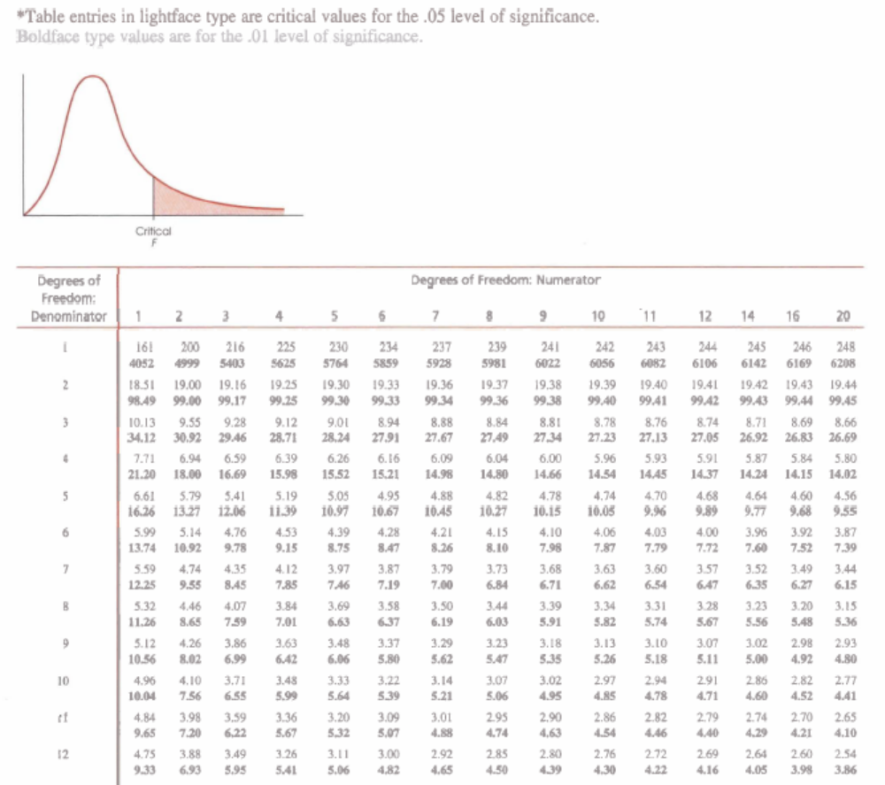
Notes:
F_{crit} = 3.98

Slide 39
Step 3: Select and compute the appropriate statistic.
Calculate the F-ratio.

Slide 40
An Example ANOVA
Country | Classical | Blues
3 | 5 | 9
2 | 3 | 8
5 | 5 | 9
2 | 2 | 7
2 |  | 9

Slide 41
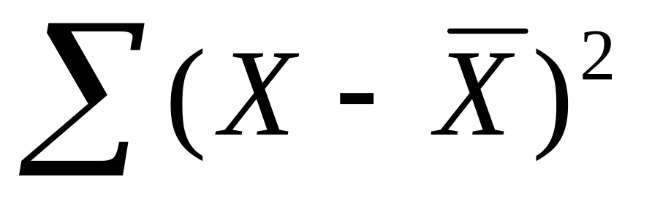
Steps in Calculating the F ratio
1. Calculate Sum of Squares (SS)
Notes:
We want the variance
the numerator of the variance formula is the SS
So the first step in calculating the variance is to calculate the SS

Slide 42
Sum of Squares
SS_{Total}
SS_{Between}
SS_{Within}
Notes:
Like variance and df, SS total can be divided into:
SS between
2. SS within

Slide 43
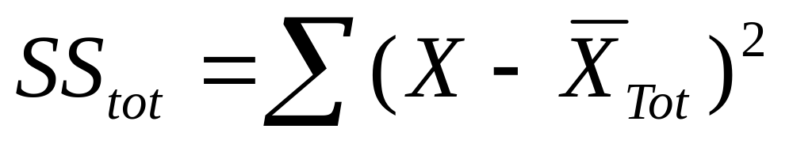
Steps in Calculating the F ratio
1a. Calculate SS_{tot}
This is the deviation of all scores from the grand mean
Calculate the grand mean
Subtract the grand mean from each score
Square each value
Add them together
Notes:
2a. Calculate SS_{tot}
This is the deviation of all scores from the grand mean
Calculate the mean of all the scores from all 3 groups
Then subtract the grand mean from each score
Square this value
Then add them together

Slide 44
SS_{tot}
Country X₁ | X₁ - M_{Tot} | (X₁ – M_{Tot})²
3 | -2.07 | 4.28
2 | -3.07 | 9.42
5 | -.07 | .005
2 | -3.07 | 9.42
2 | -3.07 | 9.42

Slide 45
SS_{tot}
Classical X₂ | X₂ - M_{Tot} | (X₂ – M_{Tot})²
5 | -.07 | .005
3 | -2.07 | 4.28
5 | -.07 | .005
2 | -3.07 | 9.42

Slide 46
SS_{tot}
Blues X₃ | X₃ - M_{Tot} | (X₃ – M_{Tot})²
9 | 3.93 | 15.44
8 | 2.93 | 8.58
9 | 3.93 | 15.44
7 | 1.93 | 3.72
9 | 3.93 | 15.44

Slide 47
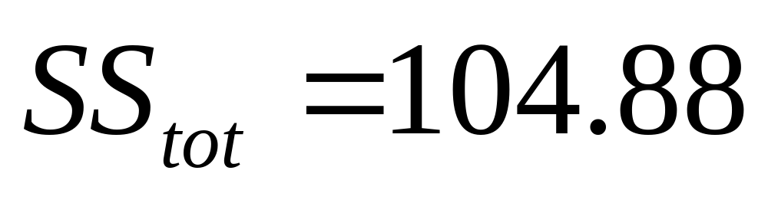
SS_{tot}

Slide 48
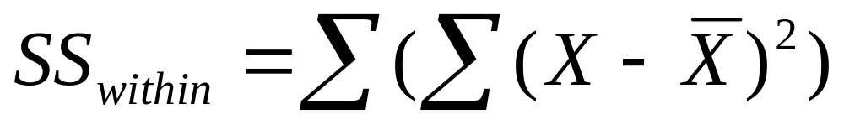
Steps in Calculating the F ratio
1b. Calculate SS_{within}
This is the sum of the deviation of each score from the mean of its own group
Find the SS for each group
Add them together
Notes:
2c. Calculate SS_{within}
This is the sum of the deviation of each score from the mean of its own group
First find the deviation of the scores in each group from its group mean, then add these 3 (or more) values together
You can also calculate SSwithin by subtracting SSbetween from SStotal
You should do it both ways so you can check your work

Slide 49
SS_{within}
Country X₁ | X₁ – M₁ | (X₁ – M₁)²
3 | .2 | .04
2 | -.8 | .64
5 | 2.2 | 4.84
2 | -.8 | .64
2 | -.8 | .64
M₁ = 2.8 |  | SS₁ = 6.8

Slide 50
SS_{within}
Classical X₂ | X₂ – M₂ | (X₂ – M₂)²
5 | 1.25 | 1.56
3 | -.75 | .56
5 | 1.25 | 1.56
2 | -1.75 | 3.06
M₂ = 3.75 |  | SS₂ = 6.74

Slide 51
SS_{within}
Blues X₃ | X₃ – M₃ | (X₃ – M₃)²
9 | .6 | .36
8 | -.4 | .16
9 | .6 | .36
7 | -1.4 | 1.96
9 | .6 | .36
M₃ = 8.4 |  | SS₃ = 3.2

Slide 52
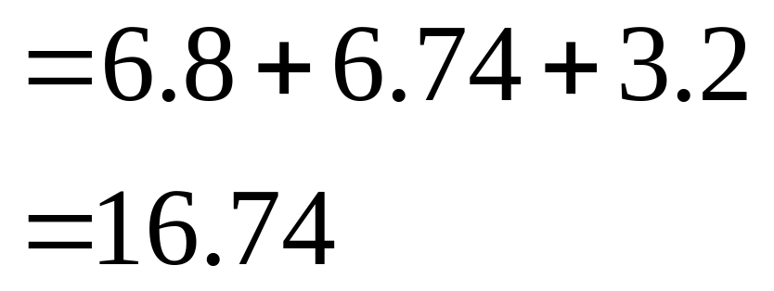
SS_{within}

Slide 53
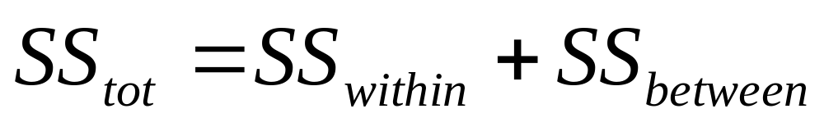
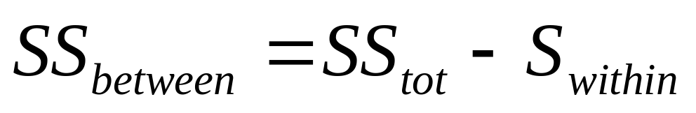
Steps in Calculating the F ratio
1c. Calculate SS_{between}
This is the deviation of each group’s mean from the grand mean, weighted by group size
Notes:
2b. Calculate SS_{between}
This is the deviation of each group’s mean from the grand mean, weighted by group size
Remember that SS total = SS within + SS between
Can rearrange the formula to find SS between

Slide 54

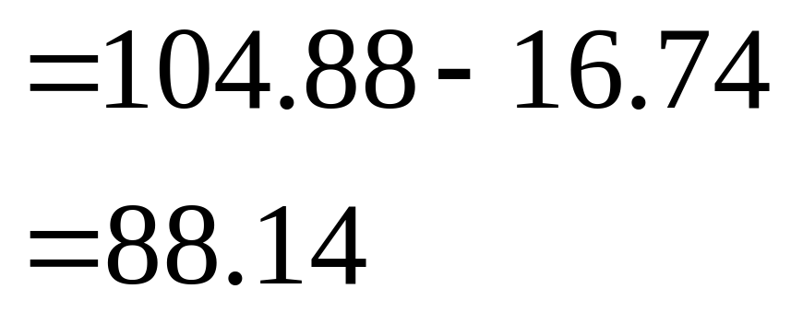
SS_{between}

Slide 55
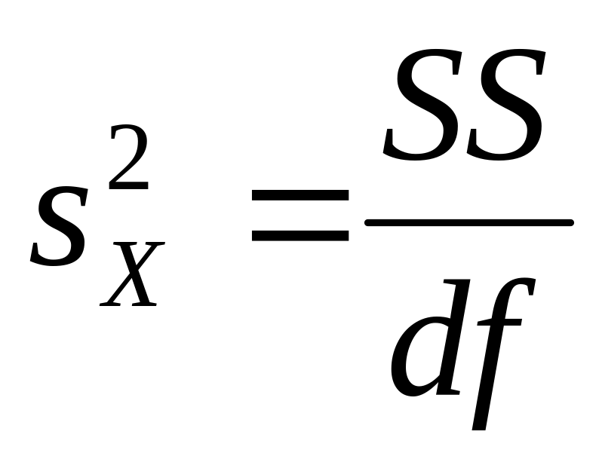
Steps in Calculating the F ratio
2. Calculate the mean square (variance)
Notes:
SS is the numerator for calculating estimated variance
df is the denominator for calculating estimated variance
Now we can calculate the variance

Slide 56
Steps in calculating the F ratio
2. Calculate the mean square (variance)
Mean square (MS):
the ANOVA term for variance
MS_{between} = SS_{between} / df_{between}
MS_{within} = SS_{within} / df_{within}
Notes:
the term for variance in an ANOVA is the Mean Squares
So we will calculate the mean squares
3. Calculate the mean squares
Mean square (MS):
the ANOVA term for variance
Variance – the mean of the squared deviations
MS_{between} = SS_{between} / df_{between}
MS_{within} = SS_{within} / df_{within}

Slide 57
MS
MS_{between} = SS_{between} / df_{between}
= 88.14/2
= 44.07
MS_{within} = SS_{within} / df_{within}
= 16.74/11
= 1.52

Slide 58
MS
MS_{between} = between-groups variance
MS_{within} = within-groups variance
Notes:
MS_{between} = between-groups variance
MS_{within} = within-groups variance
So we have the between-groups variance and the within-groups variance
What was the formula for F?

Slide 59
F-ratio

Slide 60
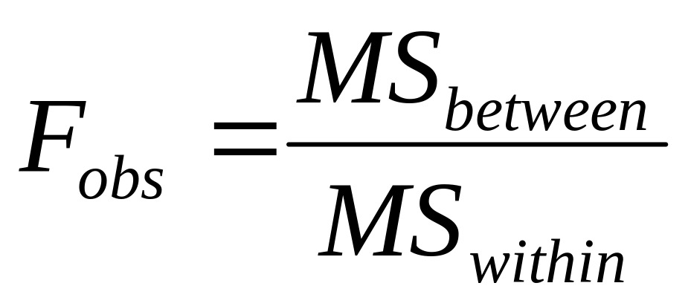
Steps in calculating the F ratio
3. Calculate the F value
Notes:
So, the final step in calculating the F-ratio is dividing:
MS between / MS within

Slide 61
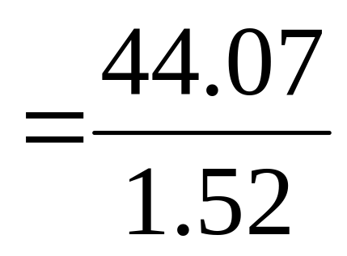
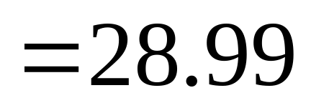
F ratio

Slide 62
ANOVA Table
Source | SS | df | MS | F
Between Groups
Within Groups
Total
Notes:
Fill in the ANOVA table

Slide 63
ANOVA Table
Source | SS | df | MS | F
Between Groups | 88.14 | 2 | 44.07 | 28.99
Within Groups | 16.74 | 11 | 1.52
Total | 104.88 | 13 |  | F_{crit} = 3.98
Notes:
The completed ANOVA table

Slide 64
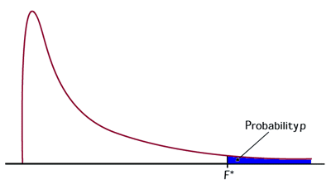
Step 4. Make a decision.
Determine whether the value of the test statistic is in the critical region. Draw a picture.
F_{crit} = ???
Notes:
The F distribution looks different from the t distribution
We’ll talk more about it in a few minutes

Slide 65
Step 4. Make a decision.
F_{crit} = 3.98
F_{obt} = 28.99
F_{obt} > F_{crit.}
Reject H₀

Slide 66
The F-Distribution

Slide 67
The F-distribution
Sampling distribution that shows the various values of F that occur when H₀ is true
Positively skewed – variance is always positive, so F_{obt} can never be < 0
Mean = 1 (most often when the H₀ is true, MS_{between} will equal MS_{within} and F will equal 1)
The larger the F, the farther in the tail it is, so the less likely it is to occur when the H₀ is true
If F_{obt} > F_{crit}, reject the null
Notes:
The F-Distribution is the sampling distribution that shows the various values of F that occur when the null hypothesis is true and all conditions represent one population
Positively skewed – variance is always positive, and since F is a ratio of 2 variances, F_{obt} can never be < 0
The mean of the distribution is 1 because, most often when the null hypothesis is true, MSbetween will equal MSwithin and F will equal 1
The larger the F, the farther in the tail it is, so the less likely it is to occur when the null hypothesis is true
If Fobt > Fcrit, reject the null

Slide 68
Results
When F_{obt} is not significant:
Indicates that are no significant differences between any of the (pairs of) group means
All means are likely to represent the same μ
Notes:
When Fobt is not significant:
Indicates that are no significant differences between any of the group means
All means are likely to represent the same μ
This is what we saw represented by the general model we looked at near the beginning of the lecture (next slide).

Slide 69
General Model for ANOVA
Sample A
H₀: μ₁ = μ₂ = μ₃
Population 1
Sample B
Sample C

Slide 70
Results
When F_{obt} is significant:
Indicates that somewhere among the group means at least two means are likely to represent different μ’s
Notes:
When Fobt is significant:
Indicates that somewhere among the group means at least two means are likely to represent different mus
Now the problem is, which ones do differ?

Slide 71
Population 1
Sample A
Population 2
Sample B
Notes:
It could be that these two differ, but C does not (i.e., it is the same as A or B)

Slide 72
General Model for ANOVA
Population 1
Sample A
Population 3
Sample C
Notes:
It could be that these two differ, but B does not (i.e., it is the same as A or C)

Slide 73
General Model for ANOVA
Population 2
Sample B
Population 3
Sample C
Notes:
It could be that these two differ, but A does not (i.e., it is the same as B or C)

Slide 74
General Model for ANOVA
H_{A}: not all μs are equal
Population 1
Sample A
Population 2
Sample B
Population 3
Sample C
Notes:
Or it could be that all three samples differ from each other and therefore come from 3 different populations.

Slide 75
Results
When F_{obt} is significant:
Must determine which means differ by performing post hoc tests
  Post hoc means “after the fact”

Slide 76
Step 5.
Report the statistical results.
Reject H₀.
F(2,11) = 28.99, p < .05
Notes:
F (df between, df within)

Slide 77
Step 6. Write a conclusion.
The means for the country, classical, and blues groups were 2.8, 3.75, and 8.4, respectively.
Based on a one-way ANOVA, there was a significant difference among the groups in number of words recalled, F(2,11) = 28.99, p < .05.

Slide 78

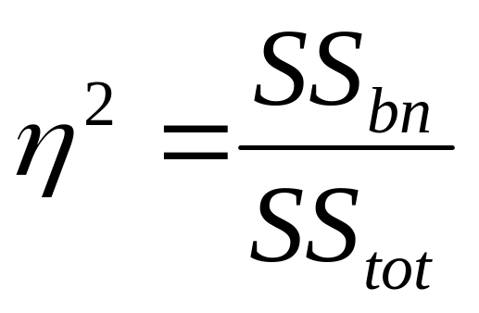
Effect Size
Eta =
Notes:
Eta squared is analogous to r squared, except that eta can be used to describe any linear or nonlinear relationship containing 2 or more levels of a factor
It is a rough estimate of the proportion of variance in the dependent scores that can be accounted for by changing the levels of the IV

Slide 79
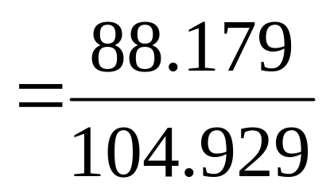
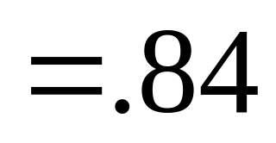
Effect Size

Slide 80
Effect Size
Type of music can account for 84% of the variance in the number of words recalled.
Notes:
84% of the variance in the number of words recalled is due to
the type of music

Slide 81
Questions?

Slide 82
Multiple Comparison Tests
A priori: before the fact
Post hoc: after the fact
Notes:
There are 2 kinds of comparisons you can make when performing an ANOVA based on whether you predicted a difference prior to performing the ANOVA or whether you found that the ANOVA was significant and now you want to know where the differences are

Slide 83
A Priori Tests
Planned comparisons that are based on reasonable expectations
Make a limited number comparisons
Comparisons are planned before performing the experiment

Slide 84
Post Hoc Tests
Tests that were not planned, but performed after you collected the data and performed an ANOVA.
Typically all possible comparisons between means are performed.

Slide 85
Post Hoc Comparisons
Scheffe Test – conservative (decreases chance for Type I errors)
Newman-Keuls – liberal (increases chance for Type I error)
Duncan Test – liberal (increases chance for Type I error)
Fisher’s Protected t-Test – moderate (use when ns are not equal)
Tukey’s HSD (Honestly Significant Difference) Test – moderate (use when ns are equal)
Notes:
There are several different versions of post hoc tests
They vary in terms of how likely a type I error is to be made when using them
Scheffe Test – conservative (decreases chance for Type I errors, increases chance for Type II errors)
Newman-Keuls – liberal (increases chance for Type I error, decreases chance for Type II errors)
Duncan Test – liberal (increases chance for Type I error, decreases chance for Type II errors)
Fisher’s Protected t-Test – in-between (use when ns are not equal)
Tukey’s HSD (Honestly Significant Difference) – in-between (use when ns are equal)
We’ll talk about the 1st and the last of these

Slide 86
Tukey’s HSD Test
Use when n's in all groups are equal
Use to compute a value for the minimum difference between two means that is required for them to differ significantly
This value is called the honestly significant difference (HSD)
Notes:
Tukey’s HSD
Use when n’s in all groups are equal
Use to compute the minimum difference between two means that is required for them to differ significantly
n = the number of scores in each level

Slide 87
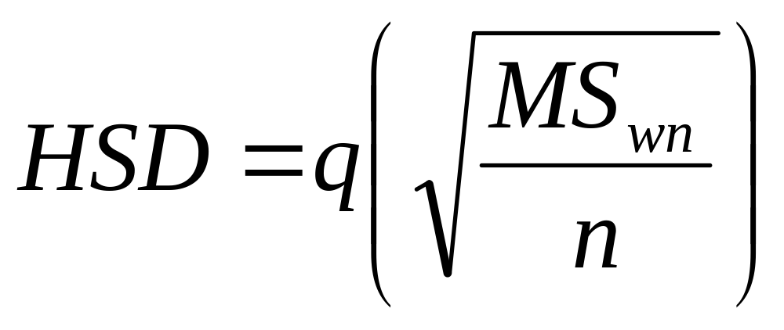
Tukey’s HSD Test
Formula:
MS_{within} ➔ from the ANOVA calculation
n ➔ the number of scores in each level of the IV
q ➔Studentized range statistic
Notes:
The formula for Tukey’s HSD

Slide 88
Tukey’s HSD: An Example
Prozac | Zoloft | Paxil
5 | 7 | 7
3 | 4 | 8
6 | 3 | 9
3 | 5 | 8

Slide 89
Tukey’s HSD: An Example
Source | SS | df | MS | F
Between Groups | 33.167 | 2 | 16.583 | 8.529
Within Groups | 17.500 | 9 | 1.944
Total | 50.667 | 11 |  | Sig = .008

Slide 90
Computing Tukey’s HSD
1. Find q from table (p. 536)
To find q, need to know:
k ➔ # of levels of the IV
  ➔ 3
df_{within}
  ➔ 9
alpha level
  ➔.05
q
  ➔ 3.95

Slide 91
Computing Tukey’s HSD
2. Compute HSD

Slide 92
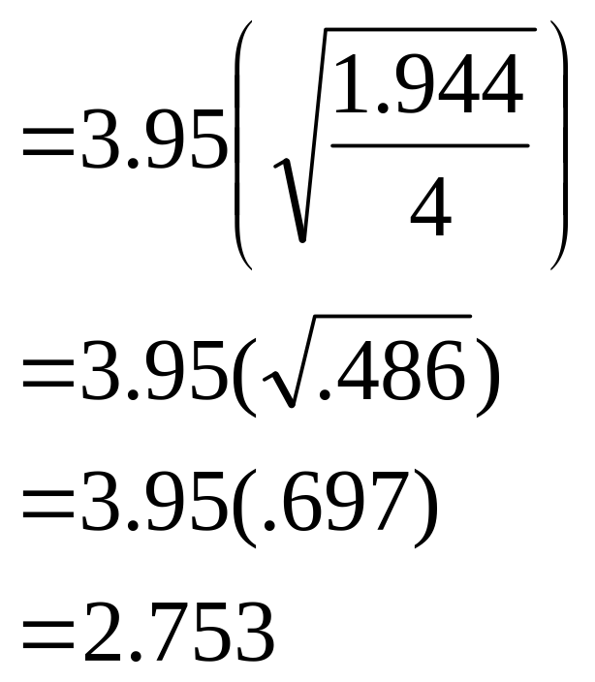
Computing Tukey’s HSD
2. Compute HSD

Slide 93
Computing Tukey’s HSD
3. Calculate the absolute value of the difference between all means.
Prozac | Zoloft | Paxil
5 | 7 | 7
3 | 4 | 8
6 | 3 | 9
3 | 5 | 8
Notes:
3. Calculate the absolute value of the difference between all means.
Mean_{Prozac} = 4.25
Mean_{Zoloft} = 4.75
Mean_{Paxil} = 8.00
What does absolute value mean?

Slide 94
Computing Tukey’s HSD
3. Calculate the absolute value of the difference between all means.
Mean_{Prozac} – Mean_{Zoloft}
= 4.25 – 4.75 = .50
Mean_{Prozac} – Mean_{Paxil}
= 4.25 – 8.00 = 3.75
Mean_{Zoloft} – Mean_{Paxil}
= 4.75 – 8.00 = 3.25
Notes:
3. Calculate the absolute value of the difference between all means.

Slide 95
Computing Tukey’s HSD
4. Compare each mean difference to the HSD.
  If the difference between the means > HSD, the means differ significantly
  If the difference between the means < HSD, the means do not differ

Slide 96
Computing Tukey’s HSD
Prozac – Zoloft: .50 < 2.753
Decision ➔ not significant
Prozac – Paxil: 3.75 > 2.753
Decision ➔ significant
Zoloft – Paxil: 3.25 > 2.753
Decision ➔ significant

Slide 97
Report the Statistical Results
Prozac – Zoloft:
Not significant, p > .05
Prozac – Paxil:
Significant, p < .05
Zoloft – Paxil:
Significant p < .05

Slide 98
Write a Conclusion.
The means for the Prozac, Zoloft, and Paxil groups were 4.25, 4.75, and 8.00, respectively.
Based on a one-way ANOVA, there was a significant difference among the groups in depression rating, F(2, 9) = 8.53, p = .008.
Tukey’s HSD post hoc tests revealed a significantly greater level of depression in the Paxil group when compared to both the Prozac group (p < .05) and the Zoloft group (p < .05). There was no significant difference in level of depression between the Prozac and Zoloft groups (p > .05).
Notes:
* Be sure to include all the necessary info in the conclusion.

